Slide 1
Accident Severity
Pamela Katali

Slide 2

Data - U.S Accidents
February 2016 to December 2020
50 U.S states
Over 1.5 million examples

Slide 3
Feature Preprocessing
Accident length
Missing values
Impute with mean value
Severity
Binning
Normalization
Min-max normalization
8 features total

Slide 4
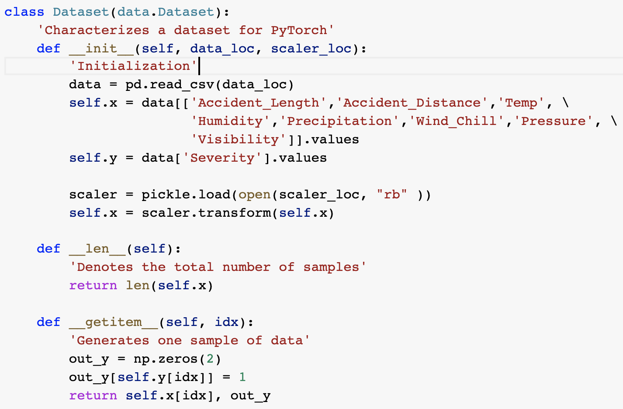

Slide 5
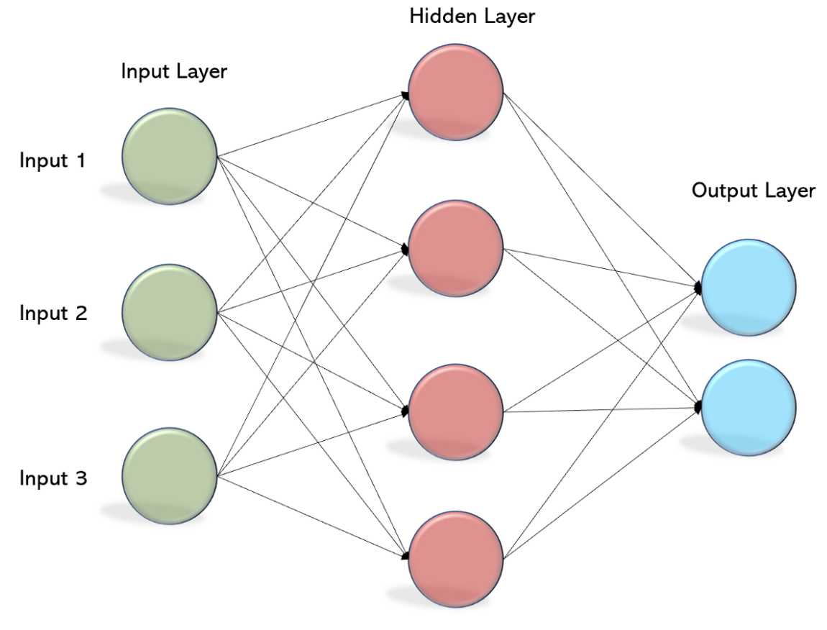
Models - MLP
Multilayer Perceptron
3 layers
Input layer - 8 neurons
Hidden layer - 4 neurons
Output layer - 2 neurons
ReLU activation
Binary Cross Entropy Loss

Slide 6
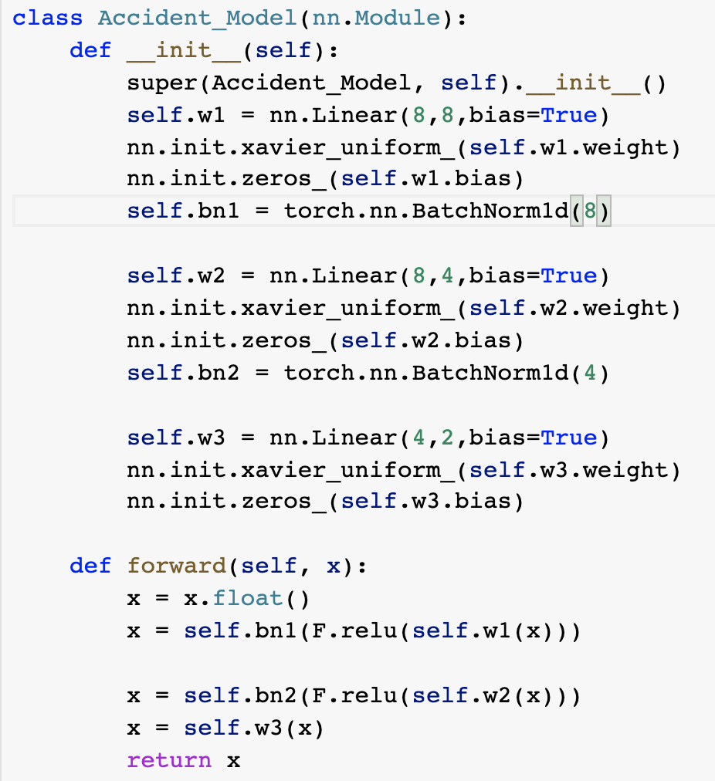

Slide 7
Results - MLP
Learning rate = 0.001
Loss weights = [2.75, 0.61]
Data imbalance - 0.8/0.2
10 epochs
Batch size - 2^16
 | Severity 0 | Severity 1
Precision | 0.4 | 0.79
Recall | 0.3 | 0.85
F1 | 0.34 | 0.82
Accuracy | 0.3 | 0.85

Slide 8
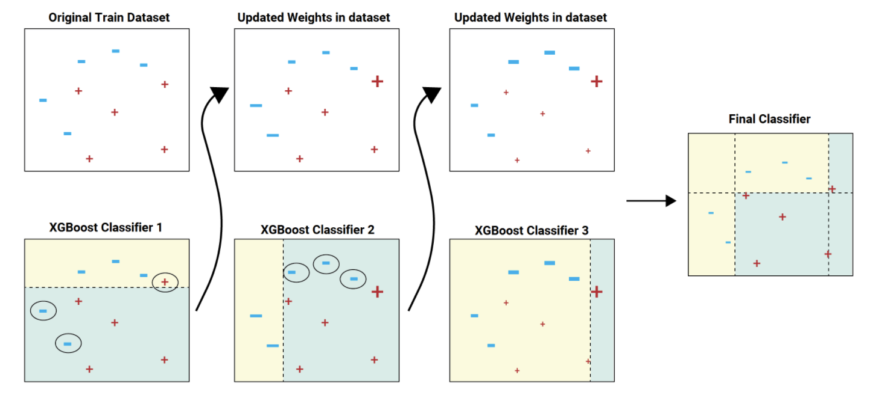
XGBoost
Gradient Boosted Trees
Max depth - 4
Rounds - 4
MLP as embedding
 | Severity 0 | Severity 1
Precision | 0.45 | 0.74
Recall | 0.28 | 0.86
F1 | 0.34 | 0.8
Accuracy | 0.29 | 0.86

